Slide 1
Project 1 Database Design For Non Profit Organization
Harika Bhemidi

Slide 2
Problem Statement:
A nonprofit organization depends on a number of different types of persons for its successful operation. The organization is interested in the following attributes for all of these persons: SSN, Name, Address, City/State/Zip, and Telephone. Three types of persons are of greatest interest: employees, volunteers, and donors. Employees have only a Date Hired attribute, and volunteers have only a Skill attribute. Donors have only a relationship (named Donates) with an Item entity type. A donor must have donated one or more items, and an item may have no donors, or one or more donors. There are persons other than employees, volunteers, and donors who are of interest to the organization so that a person need not belong to any of these three groups. On the other hand, at a given time a person may belong to two or more of these groups (e.g., employee and donor).

Slide 3
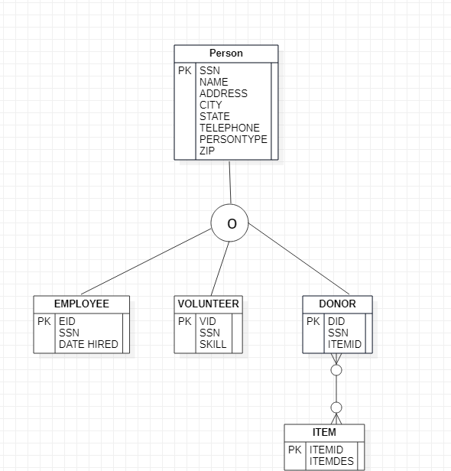
EER Diagram

Slide 4
Tables
Table Name | Column | Column | Column | Column | Column | Column | Column | Column
person | SSN | NAME | STATE | TELEPHONE | PERSONTYPE | ADDRESS | CITY | ZIP
donor | DID | SSN | ITEMID
employee | EID | SSN | SKILL | STATE
item | ITEMID | ITEMDESC
volunteer | VID | SSN | SKILL
Composite Key
Primary Key

Slide 5
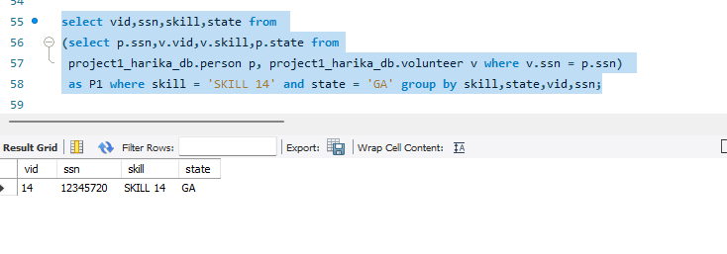
Queries:
Retrieve the details of Volunteer ID and their SSN details of volunteers who belongs to state AL with Skill level SKILL 14?
select vid,ssn,skill,state from
(select p.ssn,v.vid,v.skill,p.state from
project1_harika_db.person p, project1_harika_db.volunteer v where v.ssn = p.ssn)
as P1 where skill = 'SKILL 14' and state = 'GA' group by skill,state,vid,ssn;

Slide 6
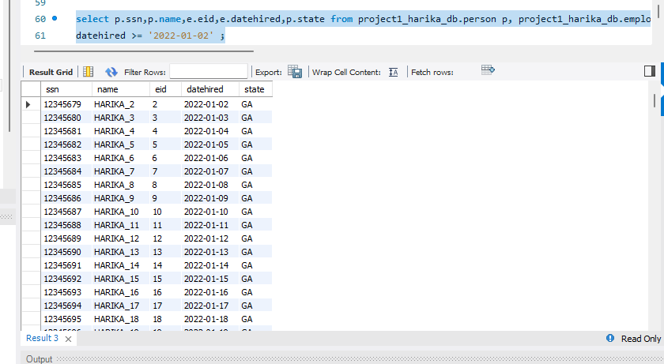
Queries:
Retrieve the details of employee who hired on or after 02/01/2022?
select p.ssn,p.name,e.eid,e.datehired,p.state from project1_harika_db.person p, project1_harika_db.employee e where e.ssn = p.ssn and
datehired >= '2022-01-02’ ;

Slide 7
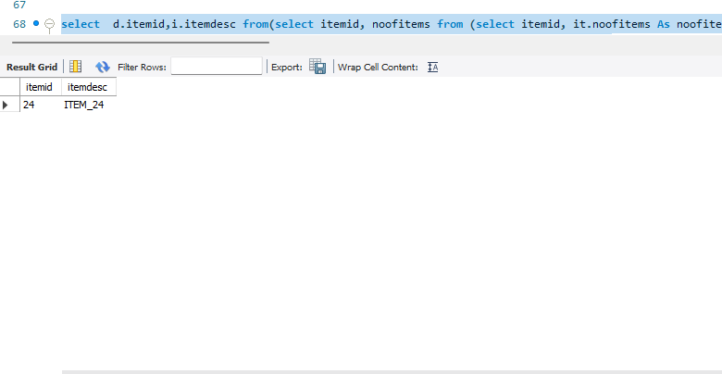
Queries:
Retrieve the item details, that are donated by mostly.
select d.itemid,i.itemdesc from(select itemid, noofitems from (select itemid, it.noofitems As noofitems, Row_Number() Over (Order By noofitems desc) As RowNum from
(select itemid,count(*) as noofitems from project1_harika_db.donor group by itemid
order by noofitems desc) as it) as it2 where RowNum<=1) as d inner join
project1_harika_db.item i on d.itemid = i.itemid;

Slide 8
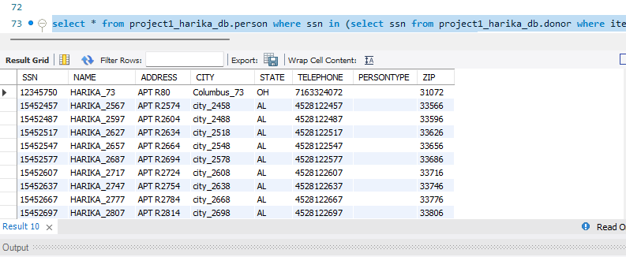
Queries:
Retrieve the donar details, who donated most number of times.
select * from project1_harika_db.person where ssn in (select ssn from project1_harika_db.donor where itemid in (select itemid from (select itemid, Row_Number() Over (Order By itemid desc) As RowNum from (select itemid,count(*) from project1_harika_db.donor group by itemid order by count(*) desc)
as t1 ) as t2 where RowNum<=1) );

Slide 9
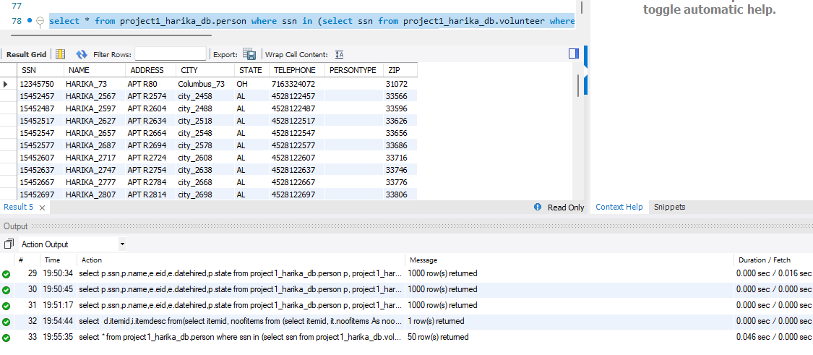
Queries:
Details of donors who are also volunteers who donated the most popular item?
select * from project1db.person where ssn in (select ssn from project1db.volunteer where ssn in (select ssn from project1db.donor where itemid in(select itemid from (select itemid, Row_Number() Over (Order By itemid desc)As RowNum from (select itemid,count(*) from project1db.donor group by itemid order by count(*) desc)
as t1 ) as t2 where RowNum<=1) ));

Slide 10
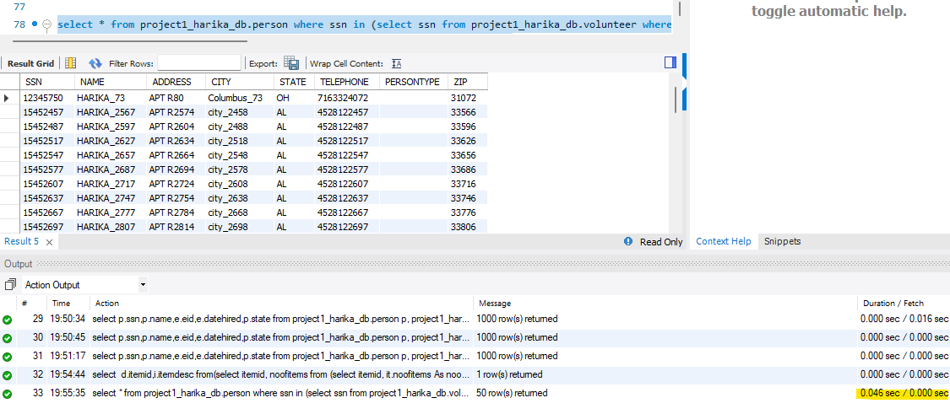
Performance Analysis on Indexing:
Query: select * from project1_harika_db.person where ssn in (select ssn from project1_harika_db.donor where itemid in (select itemid from (select itemid, Row_Number() Over (Order By itemid desc) As RowNum from (select itemid,count(*) from project1_harika_db.donor group by itemid order by count(*) desc) as t1 ) as t2 where RowNum<=1) );
Before:

Slide 11
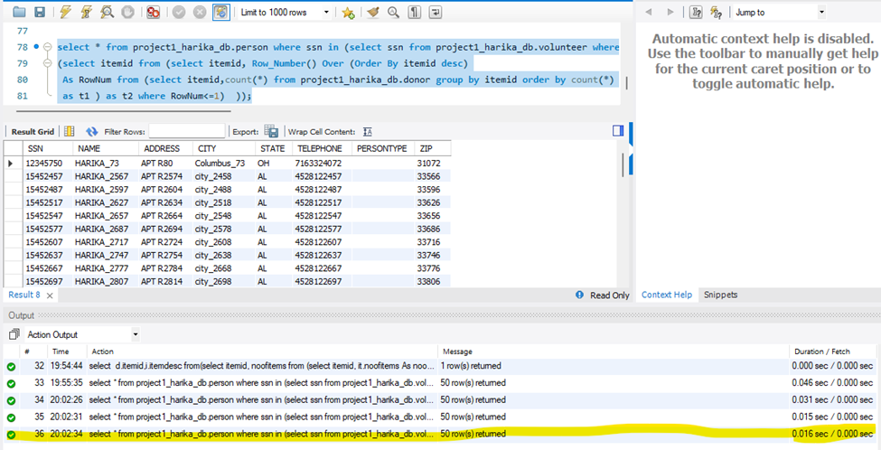
After:
It clearly shows that there is decrease in processing time after Indexing.

Slide 12
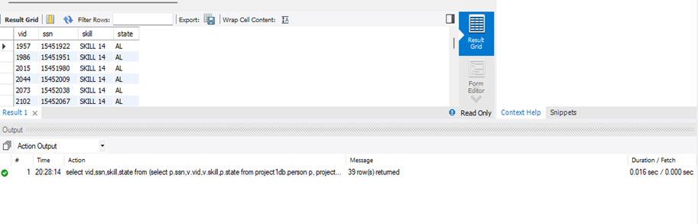
Performance Analysis on Denormalization:
Before:

Slide 13
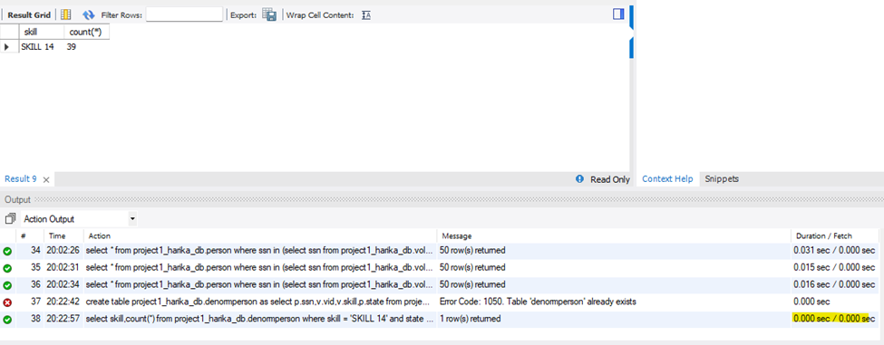
After:
It clearly shows that there is increase in time after denormalization.

Slide 14
Performance after applying different techniques
Before indexing it is 0.045 Sec.
After indexing it reduced to 0.016 Sec.
Before denormalization it is 0.015 Sec.
After indexing it reduced to 0.0001 Sec.

Slide 15
Thank You

